Slide 1
Number Plate Detection
Introduction :-
Number plates are used for identification of vehicles all over nation.
Recognizing and Detecting Number Plate is a very important task for a camera surveillance-based security system.
This method of detection and identification helps in detection of number plates of authorized and unauthorized vehicle.

Slide 2
2. Platform Details :-
We are using MATLAB for this project.
It solves technical computational problems faster than languages like C, C++ etc.
3. Technique Used :-
We are using Image Processing technique in which captured image of vehicle number plate is processed through multiple algorithms to convert the alpha numeric conversion of image into text format and displayed.

Slide 3
Input Car Image
Image Pre Processing
Character Recognition
Output Image
Plate Localization
Character Segmentation
4. Working Procedure :-

Slide 4
General NPR System:
VEHICLE IMAGE CAPTURED FROM CAMERA.
EXTRACTION OF NUMBER PLATE LOCATION
SEGMENTATION AND RECOGNITION OF PLATE NUMBER
DISPLAY VEHICLE NUMBER.

Slide 5
5. Image Processing & Plate Localization :-
Image is pre-processed through different algorithms and location of number plate is extracted. Major stages are :-
RGB to Gray scale conversion
Detection of Plate Size
Dilation of BGM (Binary Gradient Masking)
Media Filtering
Eroding of Image
Multiplication of segmented image with gray scale image.
Number Plate Image of Vehicle.

Slide 6
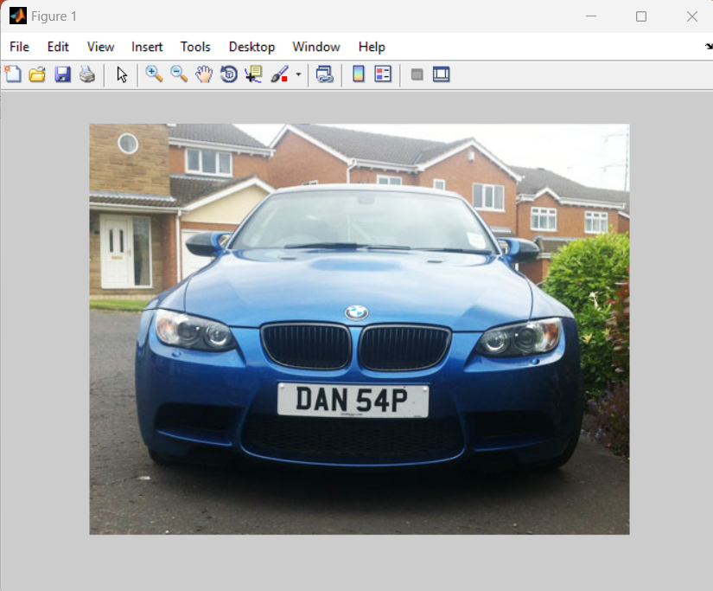
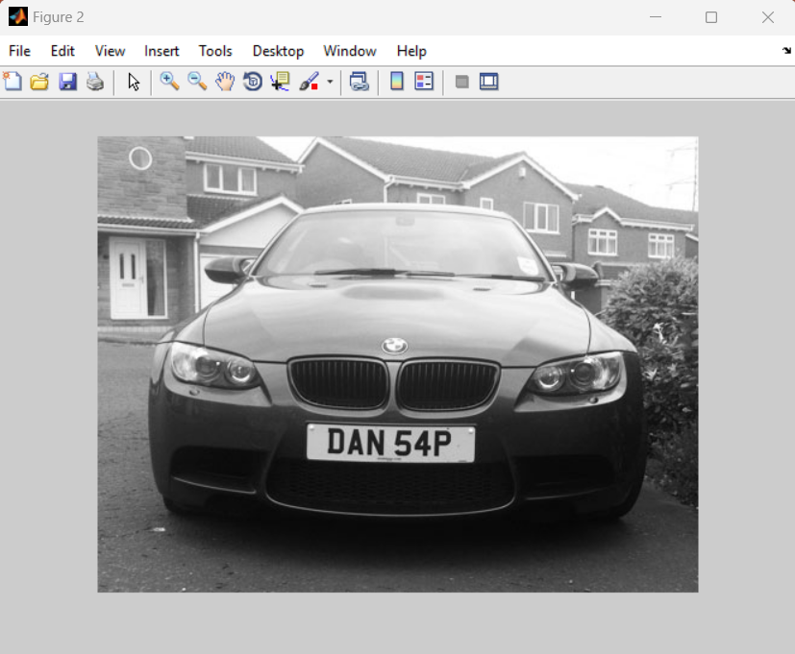
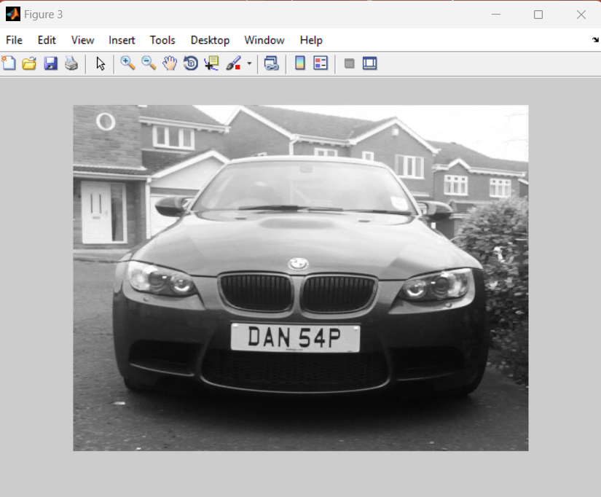
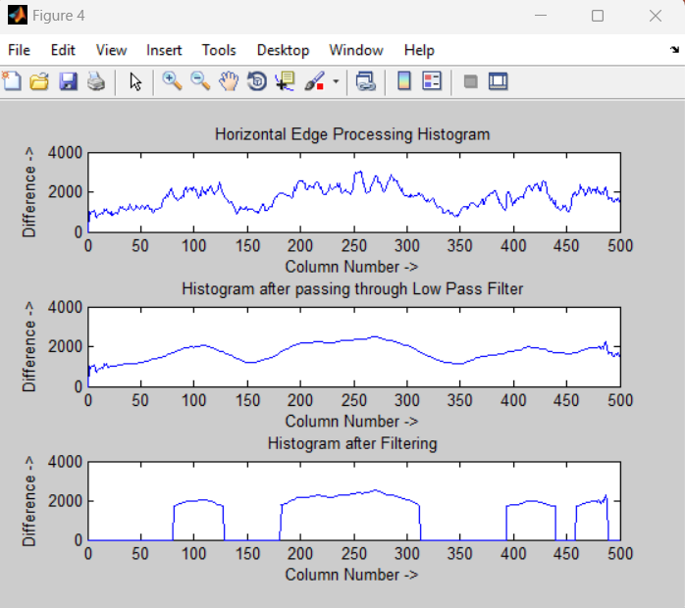
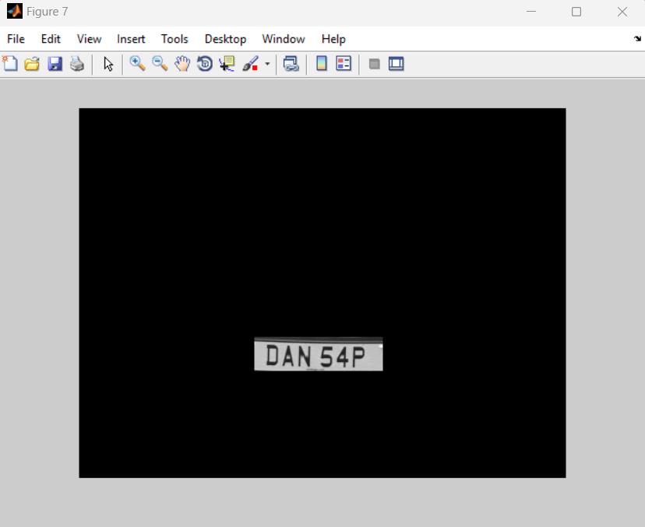
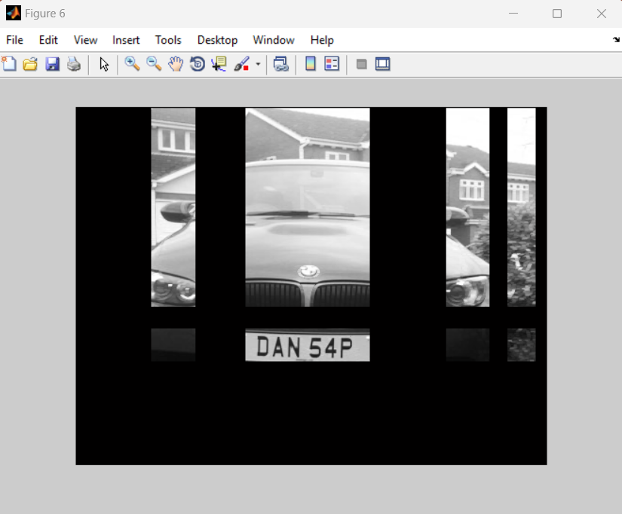
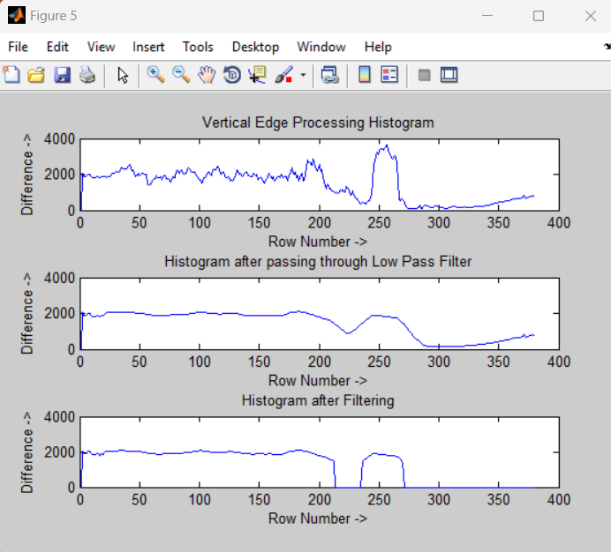
STEPS

Slide 7
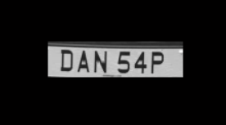
6. Character Segmentation :-
Segmentation is one of the most important processes in the number plate recognition, because all further steps rely on it.
Bounding Box Technique: It is used to measure properties of image region.
DATA USED: Real Life data is used i.e., Pictures of random number plates in different angles are used for testing.

Slide 8
8. Important MATLAB Functions and Formula Used :-
1 gray=0.114*R+0.587*G+0.299*B
I = rgb2gray(RGB) converts the true color image RGB to the grayscale intensity image I.
BW2 = imfill(BW, 'holes') fills holes in the input binary image BW.
imclearborder(I): It suppresses structures in image I that are lighter than their surroundings and that are connected to the image border.
imread(filename): It reads the image from the file specified by filename.

Slide 9
9. Applications:-
Parking : Can calculate the parking fee of vehicles.
Access control : Entry for authorized members.
Tolling : Calculate the travel fee in a toll-road or used to double check the ticket.
Border Security : Monitors the inter as well as intra crossing of vehicles.
Traffic control : Reduces the traffic congestions and number of attendants.
Airport Parking : To reduce ticket frauds or mistakes.

Slide 10
10. Conclusion:-
In this system , an application software is designed for the detection of number plate of vehicles using their number plate. At first plate location is extracted using morphological operation then separated the plate characters individually by segmentation.
Some possible difficulties :
1.Broken Number Plate.
2.Blurry Images.
3.Number plate not in legal specification.
4.poor maintenance of the vehicle plate.

Slide 11
THANK YOU!
PRESENTED BY:
Singamaneni Rushitha - 2004111
Archana Bharti - 2004099
Chaluvadi Ishwarya - 2004108

